Slide 1
CGC Linkup
Your college life, simplified.
Group members: Harshit Singla, Harshdeep Singh, Kartik Sharma, and Harshil Jain.

Slide 2

Lost in the Loop: Why the Current System Fails Students
Delays & Silences: Repairs and complaints take ages, leaving students frustrated and concerned.
Lost in the loop: Important news and events slip through the cracks.
Clutter & Waste: Discarded resources create a mess and drain finances.

Slide 3
Streamlining College Life: Addressing Key Challenges
Centralized Communication Platform: Never Miss Out: Stay informed with all college news and events in one place.
Enhanced Maintenance System: Fix It Fast: Streamlined repairs for a safer and more comfortable environment.
Resource Reuse and Redistribution: Reduce, Reuse, Repurpose: Give unwanted items a new life and minimize waste.

Slide 4
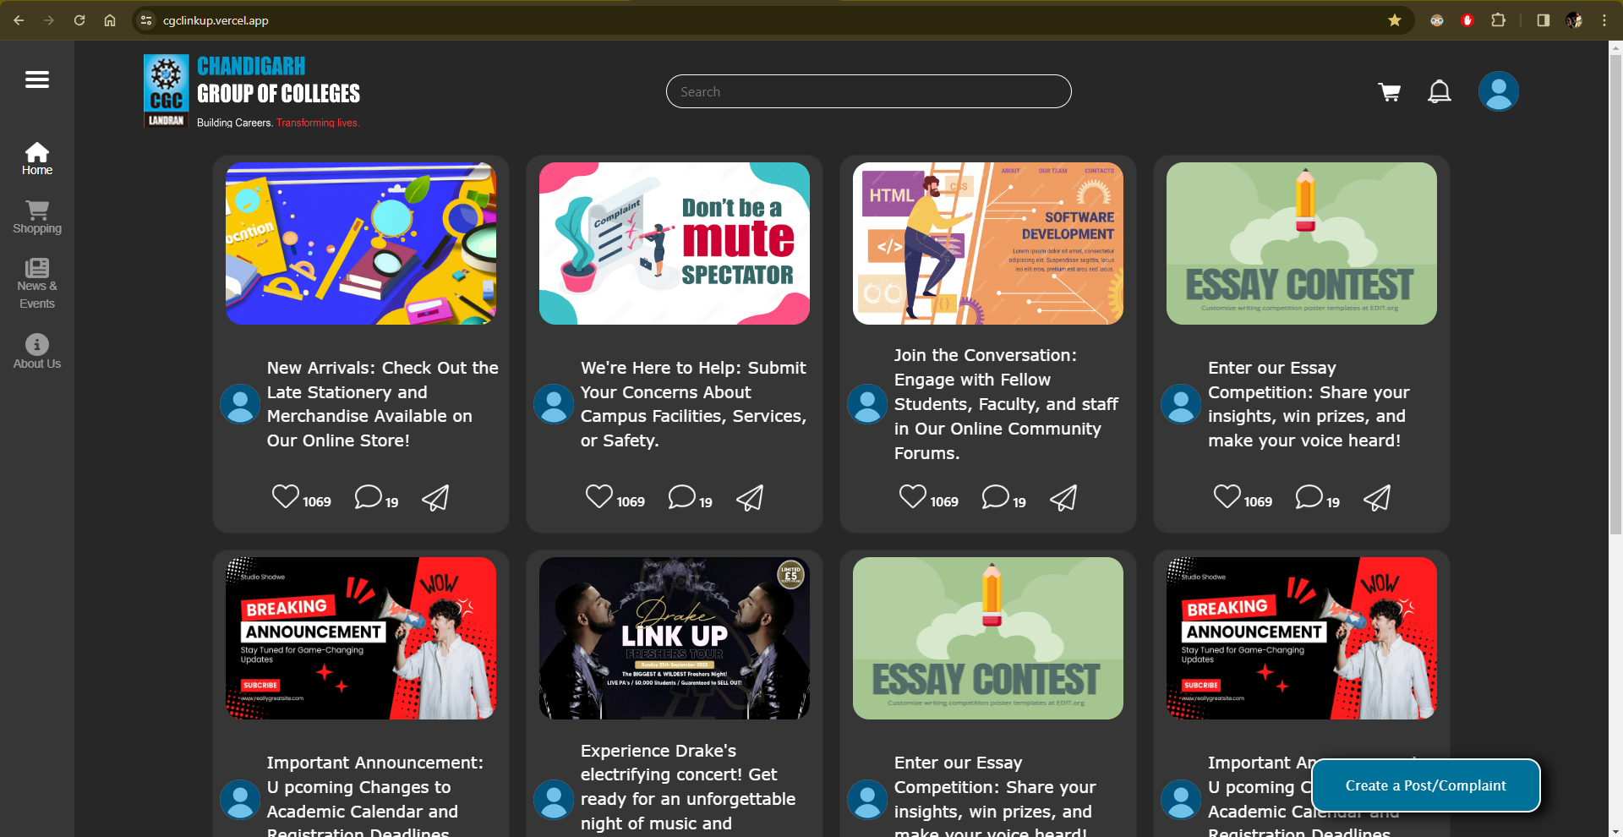
Transforming Vision into Reality: Implementing CGC Linkup

Slide 5
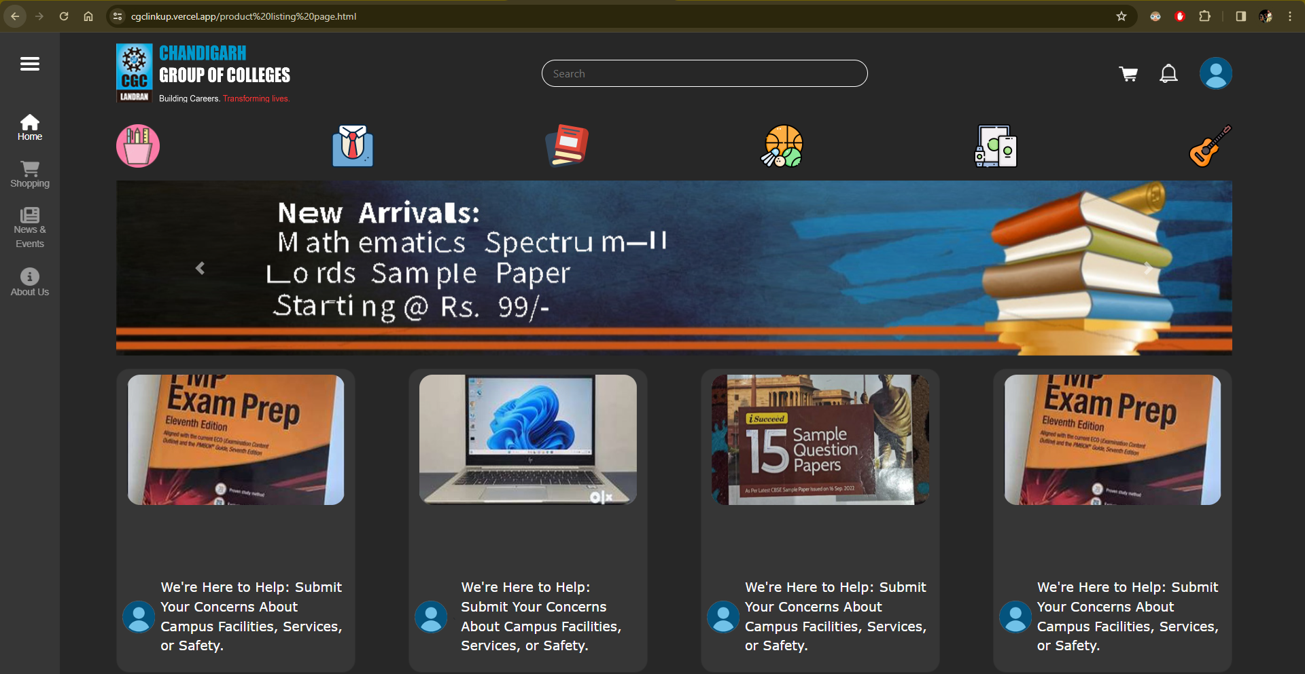
Everything students need at one location

Slide 6
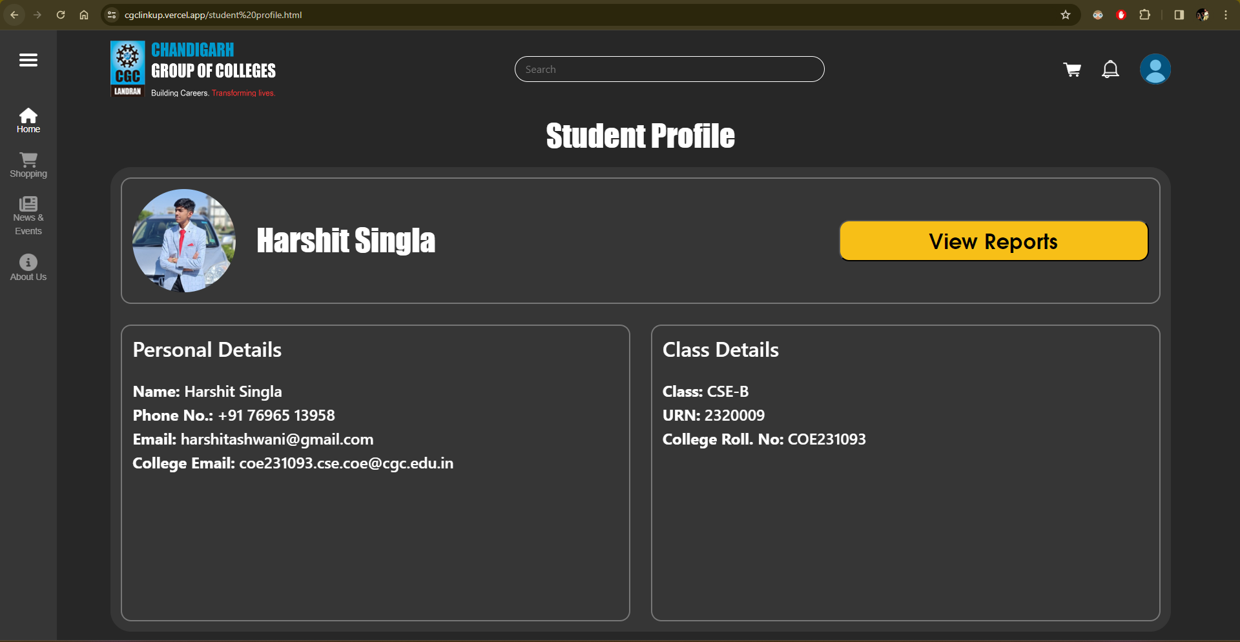
Unlock a World of Convenience: Manage Your College Life Online

Slide 7
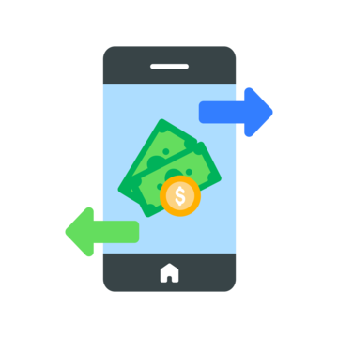



Stay Informed and In Control: Track Your Academic Journey and Manage Your Finances
Personalize your profile & keep information up-to-date.
Pay fees conveniently & stay on top of your finances.
Track attendance & stay informed about your academic progress.
Access detailed CGPA reports & monitor your academic performance.

Slide 8

Secure and Personalized Access: The User Authentication System
Secure Login: College ID for personalized access.
Data Protection: Strong passwords and multi-factor auth (optional) keep your info safe.
Your Dashboard: Personalized platform for your academic journey.

Slide 9
5 step launch plan
Student Sneak Peek
Targeted Buzz
Seamless Integration
Data Driven Growth
Keep Them Engaged
1
2
3
4
5

Slide 10
Stage | Goal | Activity | Target audience | Timeline
1. Beta test | Gather feedback & refine | Limited group of students | Early adopters | 1-2 weeks
2. Generate buzz | Create excitement & awareness | Social media campaigns, student club partnerships, targeted emails | All students | 2-3 weeks before launch
3. Smooth launch | Integrate seamlessly & raise visibility | Website integration with existing platforms | All students | Launch day & ongoing
4. Encourage engagement | Increase website usage & collect feedback | Ongoing promotions, contests, user testimonials | All students | Ongoing
5. Adapt and evolve | Continuously improve based on data | Analyse website usage data, user feedback, conduct surveys | All students | Ongoing

Slide 11

Empowering Collaboration: Partnering with the Department of Student Welfare Club
Passionate Team: Students dedicated to improving campus life run the website.
Fast Action: Direct line to administration ensures prompt responses to website concerns.
Sustainable Growth: Ongoing student feedback and commitment drive continuous improvement.

Slide 12
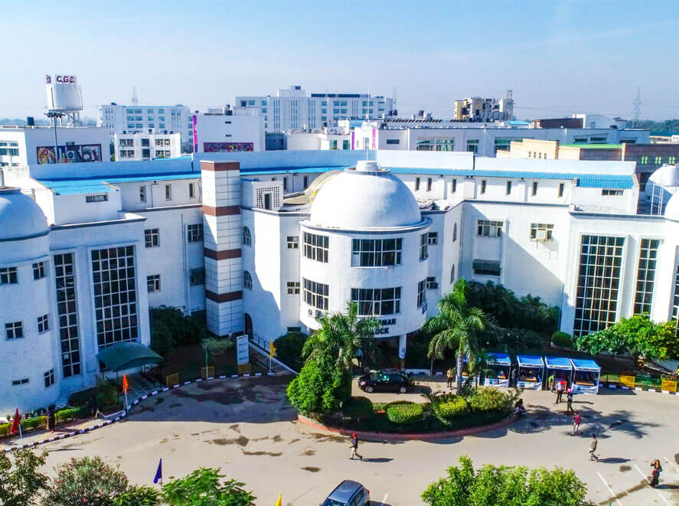
Beyond Efficiency: Fuelling Growth with CGC Linkup
CGC Linkup isn't just a convenience; it's an investment in our college's future.
Empowering students, streamlining processes, and promoting sustainability.
CGC Linkup: Building a stronger, more vibrant college community.

Slide 13

Summary: CGC Linkup - Unlocking Potential
Problem: Missed notices, slow repairs, wasted resources hinder student experience and growth.
Solution: Centralized platform for information, communication, and sustainability.
Impact: Engaged students, efficient systems, and a greener future.
Growth: Attracts & retains, boosts success, optimizes resources.
Join us: Visit, share, and build a better campus together!
Website: https://cgclinkup.vercel.app/

Slide 14
Thank you
Presented by: Harshit Single, Kartik Sharma, Harshil Jain, and Harshdeep Singh.

